Slide 1
Effective Java
Nguyen Ngoc Hai – Software Engineer

Slide 2
Agenda
Factory Method, Builder Pattern
Object Methods
Equals
HashCode
CompareTo using chaining Comparators
Lambda
Before Java 8
Functional Interfaces
Method references
Enum as Singleton

Slide 3

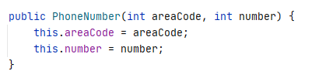

Factory Method

Slide 4
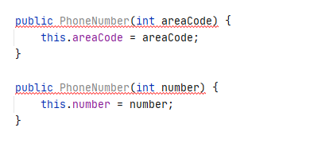
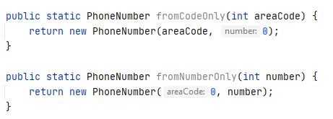
Factory Method

Slide 5
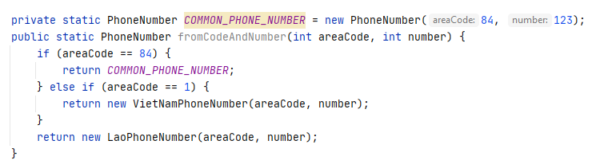
Factory Method

Slide 6
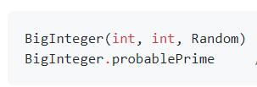

Factory Method
Advantages:
Meaningful name
Can return cached object
Can return subclass type
Disadvantage:
Providing only static factory methods means that classes without public or protected constructors cannot be subclassed.
No difference between other static methods

Slide 7
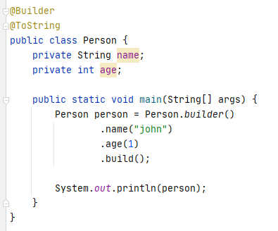

Builder Pattern

Slide 8
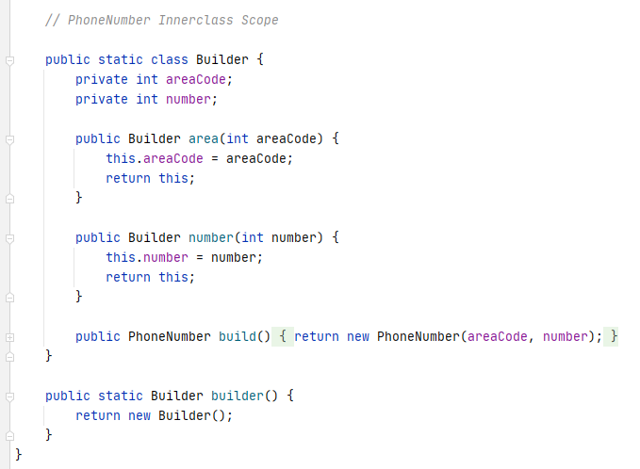
Builder Pattern

Slide 9
Builder Pattern
Advantages:
Improve readability when create complex object
Less errors as user will know what they are passing because of explicit method call
More maintainable if number of fields required to create object is more than 4 or 5.
Not need to pass null value like constructor
Disadvantage:
Code duplication as Builder needs to copy all fields from Original or Item class.

Slide 10
Object Methods
Equals: for any non-null reference value
Reflexive: x.equals(x) -> true.
Symmetric: x.equals(y) -> true if and only if y.equals(x) -> true.
Transitive: if x.equals(y) returns true and y.equals(z) returns true, then x.equals(z) should return true.
Consistent
x.equals(null) should return false.

Slide 11
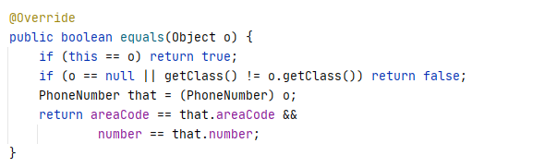
Object Methods
Equals:

Slide 12

Object Methods
Hashcode:

Slide 13
Object Methods
CompareTo:

Slide 14
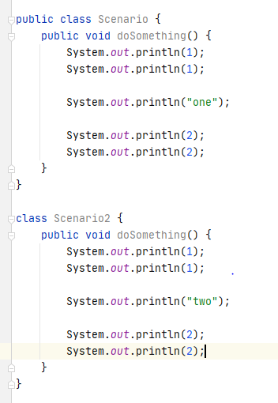
Lambda
Scenario

Slide 15
Lambda
Functional Interfaces
UnaryOperator<T>
BinaryOperator<T>
Predicate<T>
Function<T, R>
Supplier<T>
Consumer<T>
Custom functional interfaces
Method references
T -> T
(T, T) -> T
T -> Boolean
T -> R
() -> T
T -> ()

Slide 16
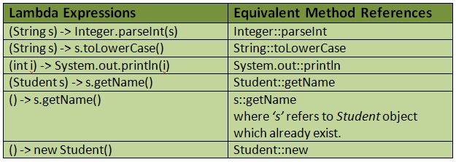
Method Reference

Slide 17
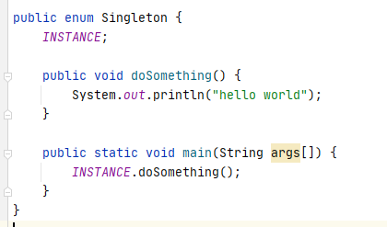
Enum as Singleton Class

Slide 18
Thanks For Listening

